Slide 1
Week 7
Continued from week 6
All data has been obtained by this point for both the RNN and FNN.
Multiple sets of optimal hyperparameters have been identified from each tuning method.
The best hyper-parameter configuration needs to be identified for each set. This will be done using a new network evaluation script.
Prediction plots and analysis will be drawn up.
Comparisons between FNN and RNN performance to be made.

Slide 2
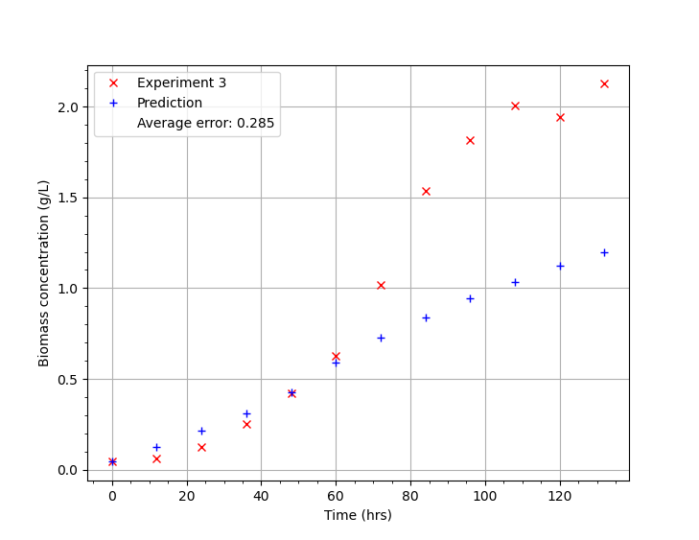
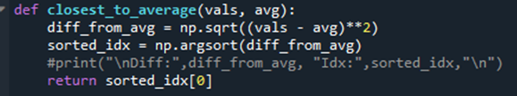

Prediction plots
Each set of hyper-parameters will be evaluated 10 times over, this would give 10 different MSE values and 10 corresponding sets of prediction data.
Averaging the MSE values is a valid means of analysis but averaging the prediction data is not. This would smooth out any distinct features of the prediction plots.
To choose which set of prediction plots to use, I find whichever value is closest to the mean from the 10 MSE values (closest_to_average()). I use the 5 prediction plots and 5 individual testing set MSE data from this value.
Images: Left shows a prediction plot for experiment 3 data for the hyperparameters HN (6, 2), 360 Epochs, 178 Batch size and 0.011 learning rate. The average MSE for all 5 prediction plots was 0.2425. Below shows the functions and relevant code used to select the prediction plot using the value which is closest to the calculated average.

Slide 3
Optimal hyperparameters: FNN
Here the 5 lowest MSE values are displayed, in order of lowest to highest, from a grid search and random search of the FNN
Grid Search: 1) HN: (4, 4), Epochs: 150, Batch Size: 10, Learn rate: 0.0002, MSE: 0.01899 2) HN: (4, 4), Epochs: 300, Batch Size: 200, Learn rate: 0.0004, MSE: 0.01942 3) HN: (4, 4), Epochs: 300, Batch Size: 300, Learn rate: 0.0004, MSE: 0.01943 4) HN: (6, 4), Epochs: 10, Batch Size: 50, Learn rate: 0.0040, MSE: 0.01973 5) HN: (4, 2), Epochs: 50, Batch Size: 50, Learn rate: 0.0010, MSE: 0.01977
Random Search: 1) HN: (4, 2), Epochs: 389, Batch Size: 121, Learn rate: 0.0003, MSE: 0.01897 2) HN: (4, 4), Epochs: 256, Batch Size: 245, Learn rate: 0.0004, MSE: 0.02032 3) HN: (4, 4), Epochs: 52, Batch Size: 234, Learn rate: 0.0017, MSE: 0.02088 4) HN: (6, 4), Epochs: 113, Batch Size: 73, Learn rate: 0.0004, MSE: 0.02102 5) HN: (4, 2), Epochs: 366, Batch Size: 239, Learn rate: 0.0005, MSE: 0.0211

Slide 4
Optimal hyperparameters: FNN
Here the optimal configurations identified from 4 runs of 250 evaluations for Bayesian Optimization and Random Forest are shown below.
Gaussian Process Bayesian Optimization: HN: (2, 8), Epochs: 71, Batch Size: 106, Learn rate: 0.0114, MSE: 0.0225473 HN: (6, 2), Epochs: 360, Batch Size: 178, Learn rate: 0.0110, MSE: 0.0240329 HN: (2, 8), Epochs: 318, Batch Size: 89, Learn rate: 0.0701, MSE: 0.0265405 HN: (10, 8), Epochs: 334, Batch Size: 31, Learn rate: 0.1000, MSE: 0.0201380
Random Forest: HN: (6, 8), Epochs: 52, Batch Size: 256, Learn rate: 0.0515, MSE: 0.0246905 HN: (4, 8), Epochs: 119, Batch Size: 265, Learn rate: 0.0912, MSE: 0.0232382 HN: (4, 6), Epochs: 355, Batch Size: 157, Learn rate: 0.0858, MSE: 0.0258024 HN: (4, 10), Epochs: 59, Batch Size: 184, Learn rate: 0.0465, MSE: 0.0277703

Slide 5
Optimal hyperparameters: RNN
Here the 5 lowest MSE values are displayed, in order of lowest to highest, from a grid search and random search of the RNN.
Grid Search:
1) HN: 4, Epochs: 25, Batch Size: 200, Learn rate: 0.1000, MSE: 0.02127
2) HN: 2, Epochs: 50, Batch Size: 250, Learn rate: 0.1000, MSE: 0.02177
3) HN: 6, Epochs: 350, Batch Size: 10, Learn rate: 0.0001, MSE: 0.02245
4) HN: 6, Epochs: 10, Batch Size: 80, Learn rate: 0.1000, MSE: 0.02247
5) HN: 2, Epochs: 25, Batch Size: 50, Learn rate: 0.0100, MSE: 0.02252
Random Search:
1) HN: 4, Epochs: 264, Batch Size: 166, Learn rate: 0.0013, MSE: 0.02197
2) HN: 3, Epochs: 43, Batch Size: 229, Learn rate: 0.0669, MSE: 0.02269
3) HN: 5, Epochs: 295, Batch Size: 195, Learn rate: 0.0013, MSE: 0.02304
4) HN: 3, Epochs: 382, Batch Size: 122, Learn rate: 0.0533, MSE: 0.02307
5) HN: 2, Epochs: 96, Batch Size: 210, Learn rate: 0.0933, MSE: 0.02322

Slide 6
Optimal hyperparameters: RNN
Here the optimal configurations identified from 4 runs of 250 evaluations for Bayesian Optimization and Random Forest are shown below.
Gaussian Process Bayesian Optimization: HN: 2, Epochs: 181, Batch Size: 127, Learn rate: 0.0412, MSE: 0.0265513 HN: 2, Epochs: 120, Batch Size: 37, Learn rate: 0.0176, MSE: 0.0256411 HN: 2, Epochs: 237, Batch Size: 139, Learn rate: 0.0377, MSE: 0.0280923 HN: 7, Epochs: 329, Batch Size: 30, Learn rate: 0.0057, MSE: 0.0247069
Random Forest: HN: 2, Epochs: 260, Batch Size: 195, Learn rate: 0.0318, MSE: 0.0247944 HN: 9, Epochs: 381, Batch Size: 135, Learn rate: 0.0003, MSE: 0.0325094 HN: 2, Epochs: 252, Batch Size: 105, Learn rate: 0.0301, MSE: 0.0264637 HN: 9, Epochs: 348, Batch Size: 82, Learn rate: 0.0989, MSE: 0.0316177

Slide 7
High data variation
Despite looping 10 network evaluations, there is still significant variation in the results. From the results I identified the lowest MSE (average of 10). From two sets of evaluations, I concluded different results. This makes it hard to identify the ‘optimal’ solution from a set of ‘optimal’ solutions. See below.
From Network Evaluations 1.txt. Lowest MSE for each method:
Random Search MSE 0.0366 HN: (4, 4), Epochs: 256, Batch Size: 245, Learn rate: 0.0004
Grid Search: MSE 0.0386 HN: (4, 2), Epochs: 50, Batch Size: 50, Learn rate: 0.0010
Random Forest: MSE 0.0394 HN: (4, 10), Epochs: 59, Batch Size: 184, Learn rate: 0.0465
Bayesian: MSE 0.0469 HN: (2, 8), Epochs: 71, Batch Size: 106, Learn rate: 0.0114
From Network Evaluations 2.txt. Lowest MSE for each method:
Grid: MSE 0.0351 HN: (4, 4), Epochs: 150, Batch Size: 10, Learn rate: 0.0002
Random: MSE 0.0396 HN: (4, 4), Epochs: 52, Batch Size: 234, Learn rate: 0.0017
Random Forest: MSE 0.0390 HN: (4, 6), Epochs: 355, Batch Size: 157, Learn rate: 0.0858
Bayesian: MSE 0.0397 HN: (10, 8), Epochs: 334, Batch Size: 31, Learn rate: 0.1000
I tested one configuration 12 times, giving a total of 120 evaluations since each test loops 10 times. HN: (2, 8), Epochs: 71, Batch Size: 106, Learn rate: 0.0114. This gave the MSE value results;
[0.0744,0.0567,0.0742, 0.0811,0.0469,0.0914, 0.0822, 0.0481, 0.0668, 0.0412, 0.0677, 0.0522] (12 runs of script)
Mean = 0.0652 +/- 0.0154. i.e. a standard deviations of +/- 24% !!!
To rectify this, I will instead evaluate each set of hyperparameters 100 times. This will give a statistically significant sample size and much more consistent means and standard deviations. Then I will carefully compare the both mean and the standard deviation to help me pick out optimal hyperparameters. In following slides, each hyperparameter set was evaluated 100 times, the optimal value found from each tuning method was evaluated a further 200 times.

Slide 8
Comparing the optimal solutions
The optimal solution for each method for both the RNN and FNN was identified. Each of these will undergo 200 further evaluations and have their prediction data plotted. From these plots I will compare between FNN and RNN output for each method. After analysing the prediction plots (shown in following slides) enabled a grade to be given to the performance of each method, relative to the same Network type (FFN grades not correlated to RNN, standalone between networks).
FNN: Grid - HN: (4,2), Epochs: 50, Batch Size: 50, Learn rate: 0.001, MSE: (0.0321 ± 0.0059) A/B (as good as Bayesian) Random - HN: (6,4), Epochs: 113, Batch Size: 73, Learn rate: 0.0004, MSE: (0.0318 ± 0.0051) C R Forest - HN: (4,10), Epochs: 59, Batch Size: 184, Learn rate: 0.0465, MSE: (0.0416 ± 0.0100) D Bayesian - HN: (4,2), Epochs: 133, Batch Size: 143, Learn rate: 0.0008, MSE: (0.0332 ± 0.0060) A/B
RNN: Grid - HN: 6, Epochs: 350, Batch Size: 10, Learn rate: 0.0001, MSE: (0.0425 ± 0.0067) C Random - HN: 4, Epochs: 264, Batch Size: 166, Learn rate: 0.0013, MSE: (0.0404 ± 0.0100) A R Forest - HN: 9, Epochs: 381, Batch Size: 135, Learn rate: 0.0003 MSE: (0.0384 ± 0.0047) B Bayesian - HN: 2, Epochs: 120, Batch Size: 37, Learn rate: 0.0176, MSE: (0.0581 ± 0.0237) D
For the FNN, each method, besides random forest, identified hyperparameters which consistently gave low errors. It can also be inferred that epochs and learning rate are the two most significant hyperparameters. Batch size is not as significant, if it was, we would see batch sizes lower than 100 in all cases as per the 2D epoch v batch size heat map plot. However, it does still contribute to the overall accuracy to some degree as all batch size values are less than 200 (300 was our upper limit). Hidden neuron configurations do not seem to have too much of an effect, although using the more optimal of these enables access to even lower errors.
This was not the case for the RNN. Only grid search and random forest found optimal values which gave a reasonably low mean squared error. The random search configuration had a particularly bad performance, with a very high MSE and variance despite lying within the optimal region as would be concluded according to the heat map analysis.

Slide 9
Prediction plots
The following slides will show 5 prediction plots for each method, for both the FNN and RNN in turn. The average error from the testing set used for the particular plot, is displayed in the legend.
Some selected plots will be produced to show the most optimal configuration and to illustrate some comparisons.

Slide 10
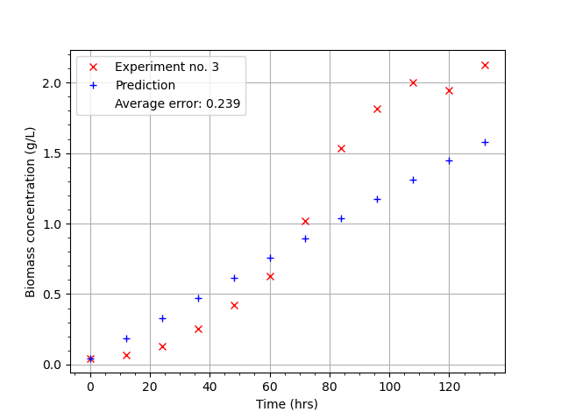
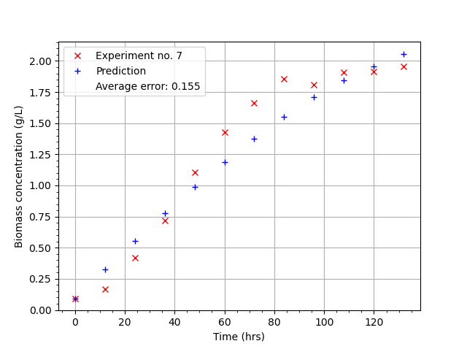
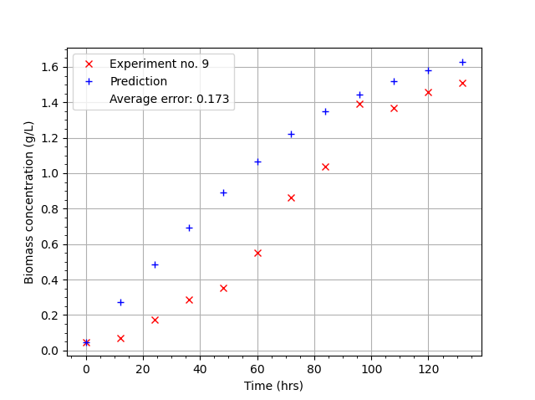
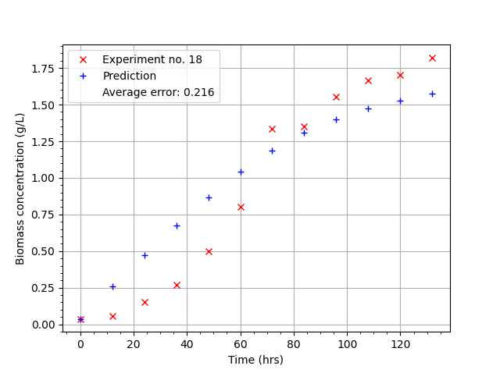
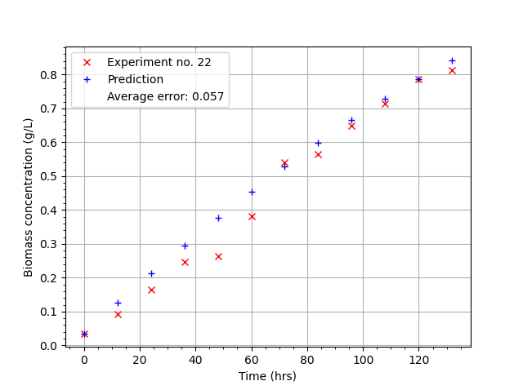
FNN Grid Search
HN: (4, 2), Epochs: 50, Batch Size: 50, Learn rate: 0.0010
MSE: (0.0321 ± 0.0059),
Mean Error: (0.1783 ± 0.0169)
3 good plots (7, 18, 22) A/B
2 decent (3, 9)

Slide 11
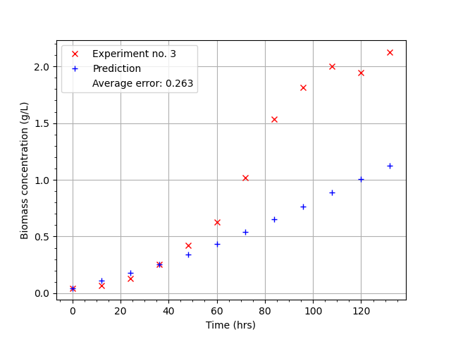
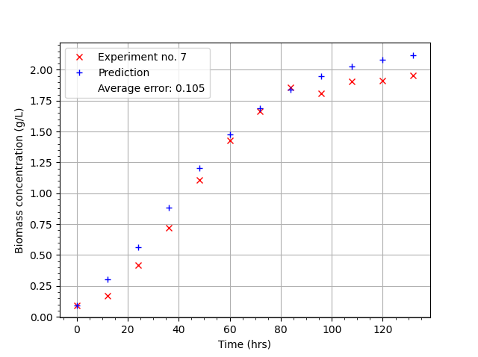
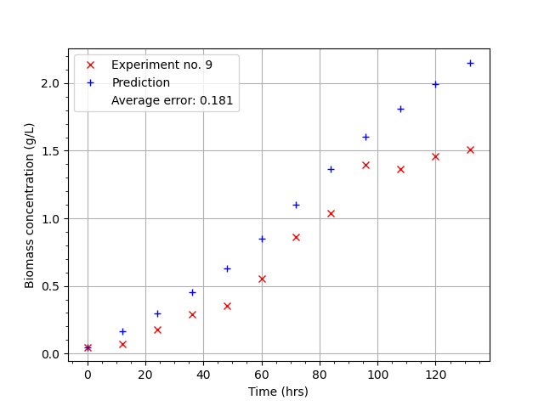
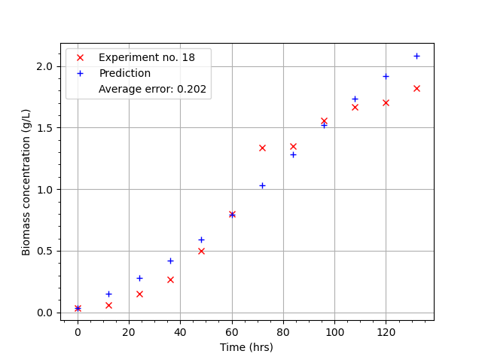
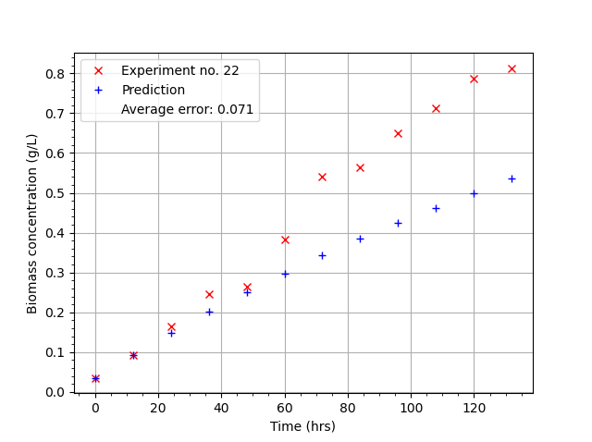
FNN Random Search
HN: (6, 4), Epochs: 113, Batch Size: 73, Learn rate: 0.0004
MSE: (0.0318 ± 0.0051),
Mean Error: (0.1777 ± 0.0144)
2 good plots (7,18) C
1 decent plot (9)
2 bad (3,22)

Slide 12
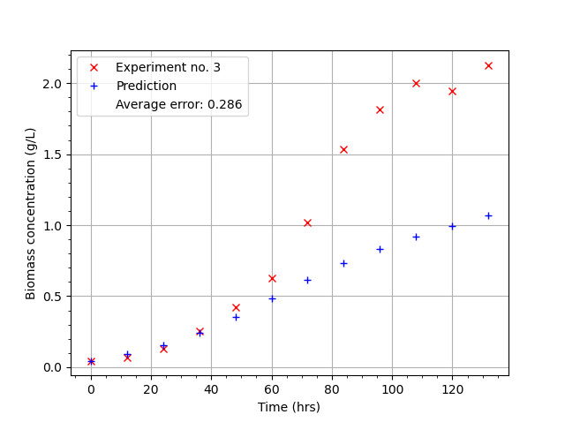
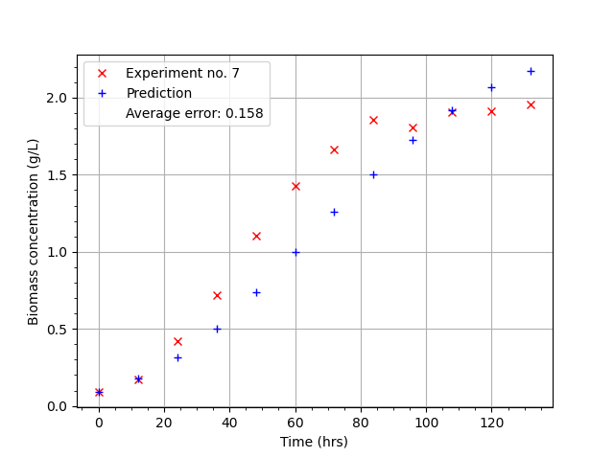
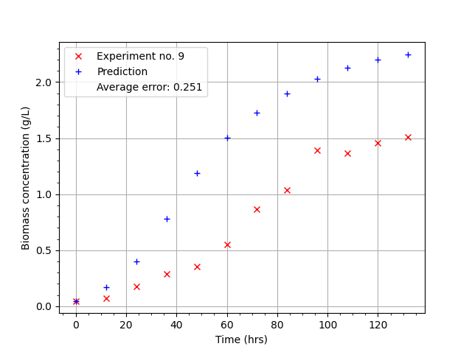
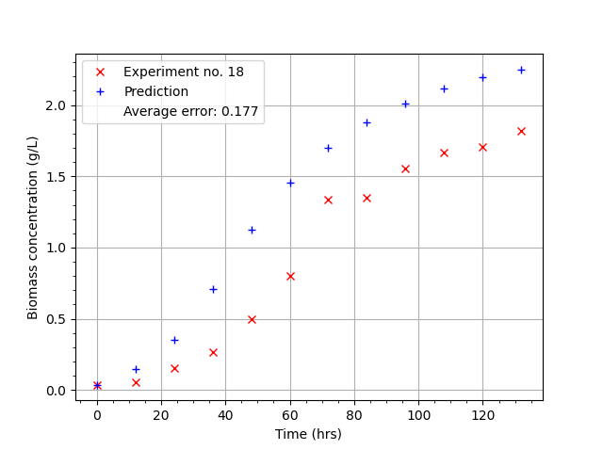
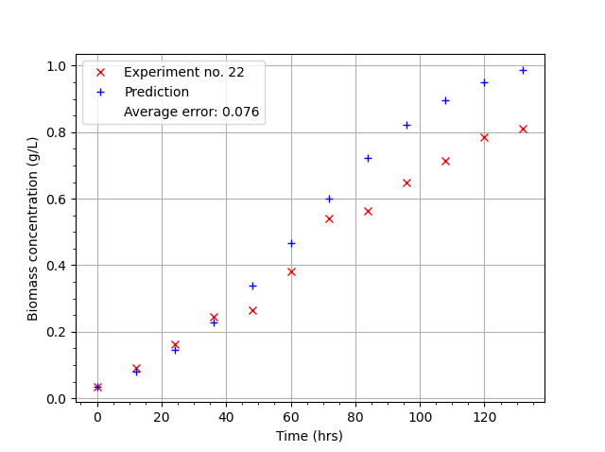
FNN Random Forest
HN: (4, 10), Epochs: 59, Batch Size: 184, Learn rate: 0.0465
MSE: (0.0416 ± 0.0100),
Mean Error: (0.2026 ± 0.0233)
1 good (7) D
2 decent (18,22)
2 bad (3,9)

Slide 13
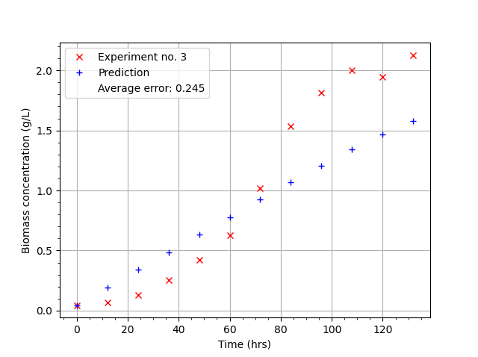
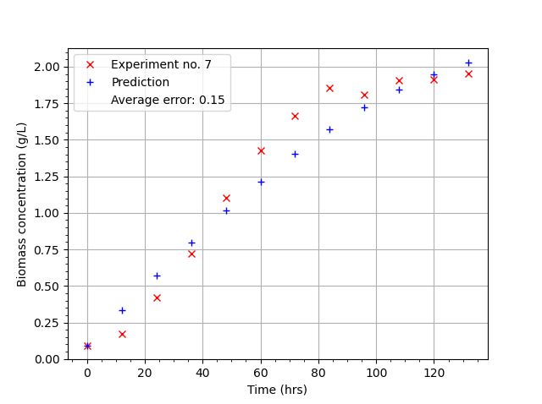
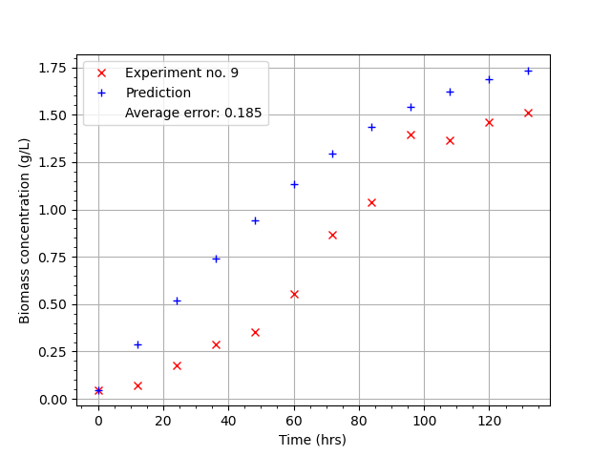
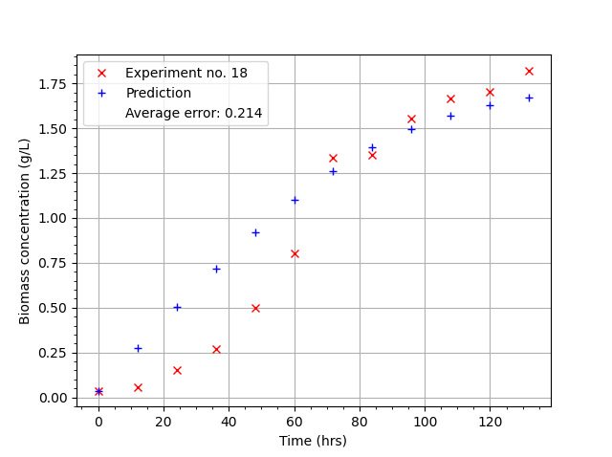
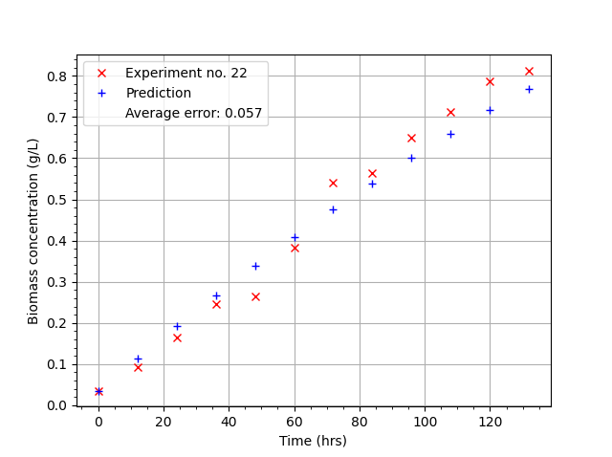
FNN Bayesian
HN: (4, 2), Epochs: 133, Batch Size: 143, Learn rate: 0.0008
MSE: (0.0332 ± 0.0060),
Mean Error: (0.1814 ± 0.0170)
3 good plots (7,18,22) A/B
2 decent (3,9)
(same as grid search)

Slide 14
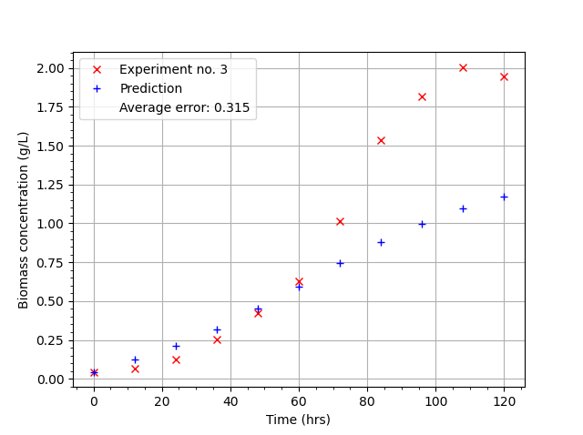
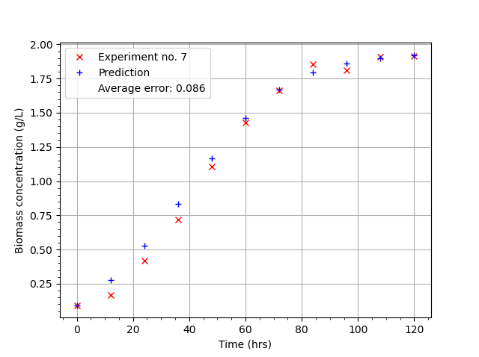
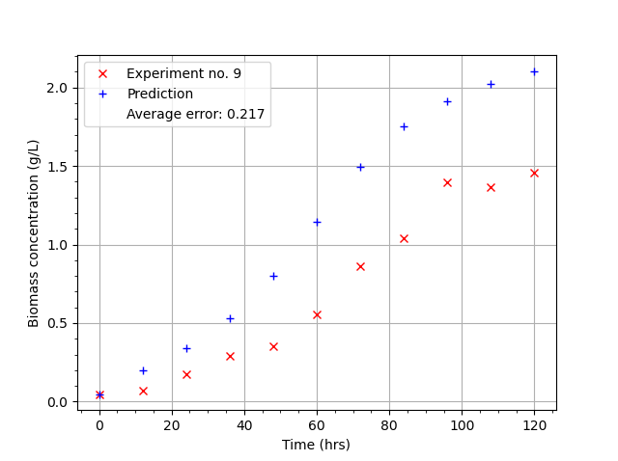
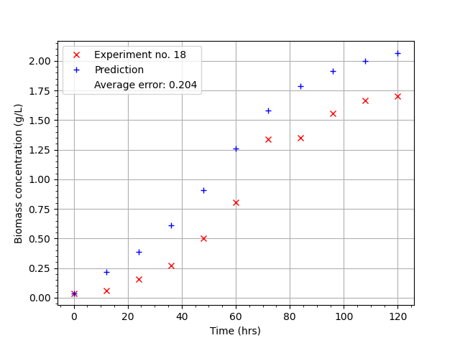
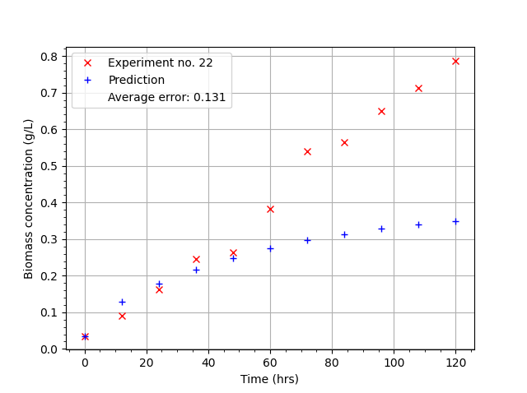
RNN Grid Search
HN: 6, Epochs: 350, Batch Size: 10, Learn rate: 0.0001 MSE(0.0425 ± 0.0067),
Mean Error: (0.2056 ± 0.0162)
1 good plot (7) C
1 decent (18)
3 bad (3,9,22)

Slide 15
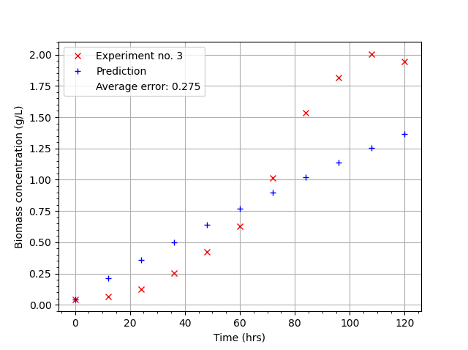
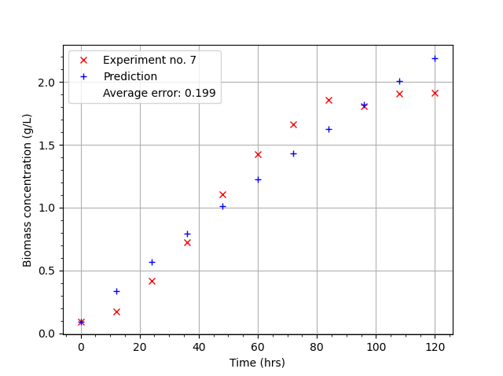
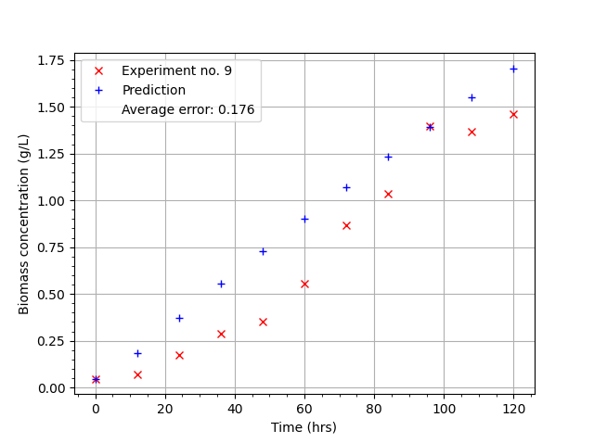
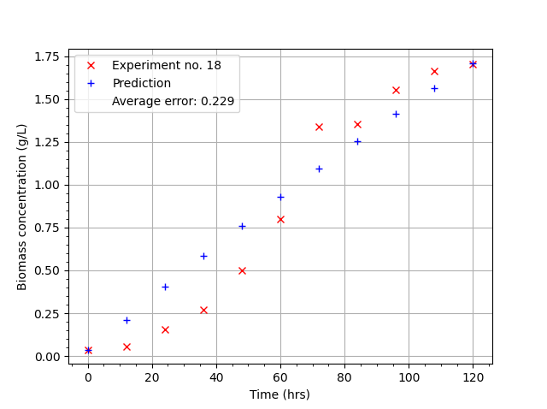
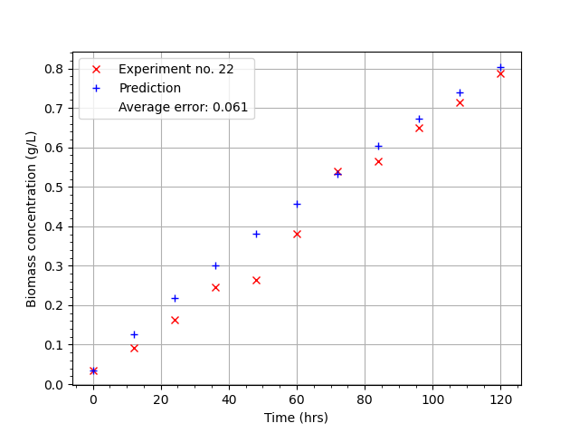
RNN Random Search
HN: 4, Epochs: 264, Batch Size: 166, Learn rate: 0.0013 MSE(0.0404 ± 0.0100),
Mean Error: (0.1994 ± 0.0248)
3 good plots ( 7, 18, 22) A
2 bad plot (3, 9)
The prediction is very linear and underfitted. No attempt to match the data curving.

Slide 16
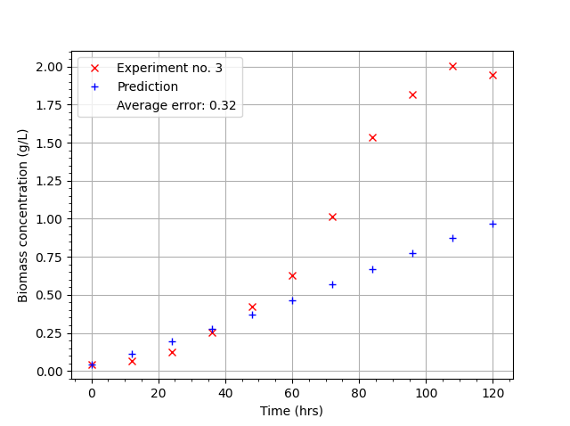
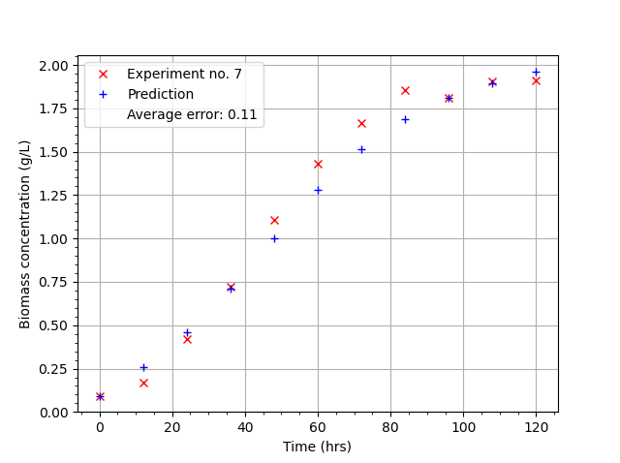
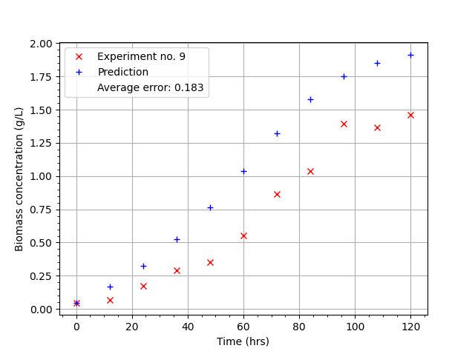
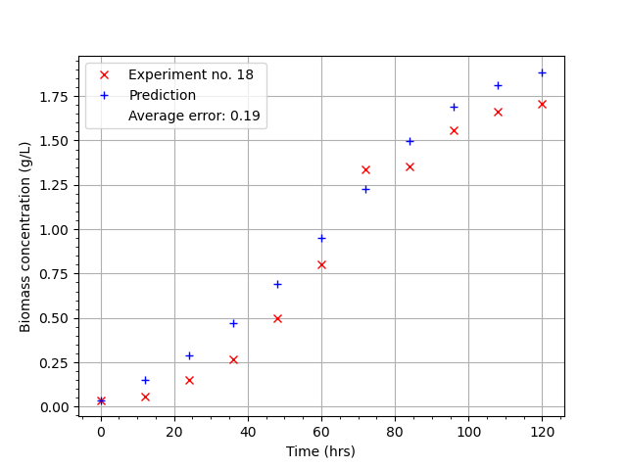
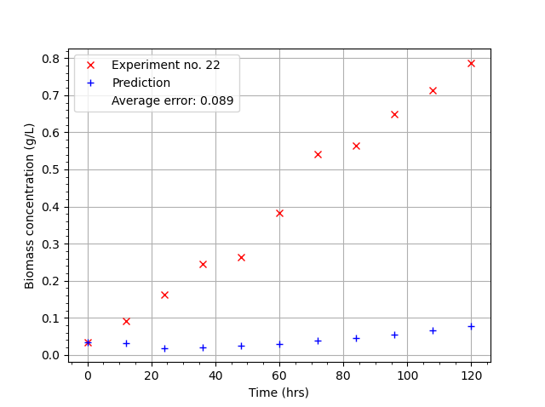
RNN Random Forest
HN: 9, Epochs: 381, Batch Size: 135, Learn rate: 0.0003 MSE: (0.0384 ± 0.0047),
Mean Error: (0.1956 ± 0.0120)
2 good plots (7, 18) B
1 decent (9)
1 bad (3)
1 Really shit one (22) (note the significant change in scale, neural net couldn’t handle it)

Slide 17
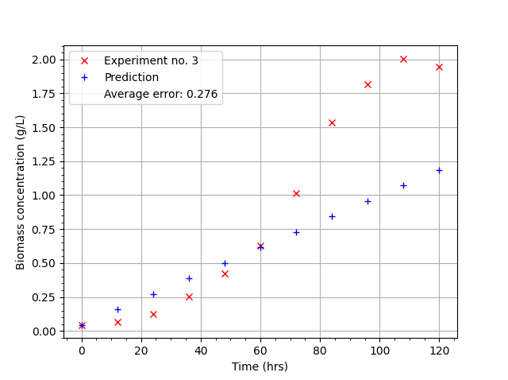
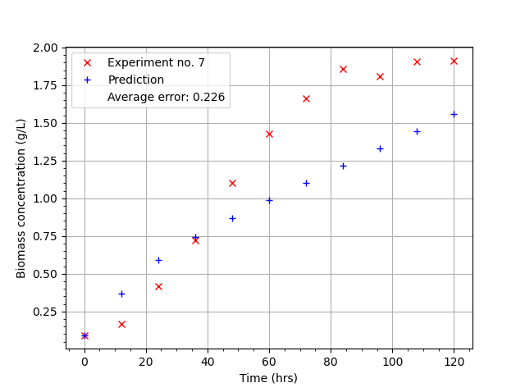
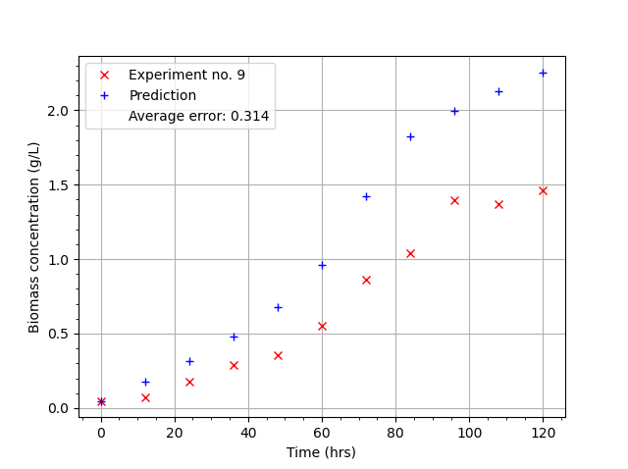
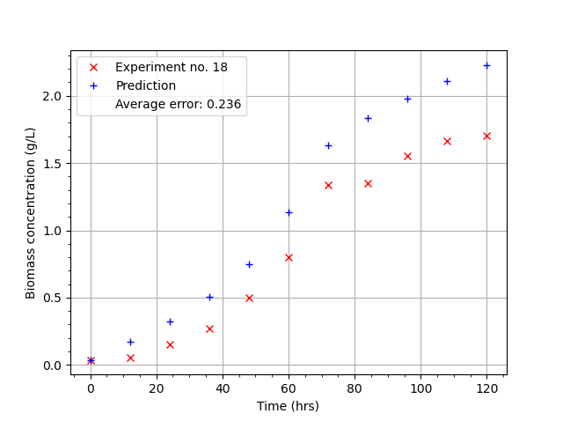
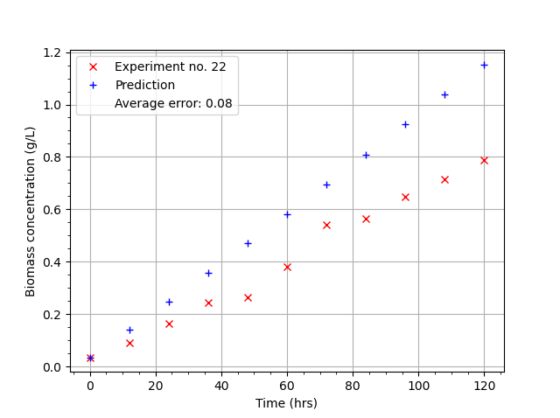
RNN Bayesian
HN: 2, Epochs: 120, Batch Size: 37, Learn rate: 0.0176 MSE: (0.0581 ± 0.0237),
Mean Error: (0.2364 ± 0.0475)
2 decent (18, 22) D
3 bad (3, 7, 9)

